Slide 1
Enzymes

Slide 2
Enzymes are biological catalysts produced by the living cells and they catalyze several reactions in the body.
They are protein in nature.
They are specific in its action (i.e. each enzyme can catalyze only one type of reaction).
They are required in very small quantities.
The loss of catalytic activity was observed when they are subjected to heat or strong acids or bases or organic solvents.

Slide 3
The enzymes mainly catalyze the metabolic pathways in the body.
The deficiency of the enzyme leads to inborn errors of metabolism.
Most of the enzymes are produced by the cells of a particular tissue and function within that cell. Such en zymes are called intracellular enzymes (Example: enzymes of glycolysis, TCA cycle and fatty acid synthesis).

Slide 4
On the other hand there are certain enzymes, which are produced by the cells of a particular tissue from where these are liberated for use in the other tissues. Such enzymes are called extracellular enzymes. (Example: various proteolytic enzymes of gastrointestinal tract as Trypsin and Chymotrypsin).
The enzyme binds with its specific substrate and forms an enzyme-substrate complex.
At the end of the reaction the substrate is converted into the product and the enzymes remain unchanged.

Slide 5
In enzymatic reactions, the molecules at the beginning of the process, called substrates, are converted into different molecules, called products.
Almost all chemical reactions in a biological cell need enzymes.

Slide 6
Like all catalysts, enzymes work by lowering the activation energy for a reaction, thus increasing the rate of the reaction. As a result, products are formed faster and reactions reach their equilibrium state more rapidly.
Most enzyme reaction rates are millions of times faster than those of comparable un-catalyzed reactions.
Enzymes are not consumed by the reactions they catalyze, nor do they alter the equilibrium of these reactions.
Enzymes are known to catalyze about 4,000 biochemical reactions.

Slide 7
A few RNA molecules called ribozymes also catalyze reactions, with an important example being some parts of the ribosome.
Enzyme activity can be affected by other molecules.
Inhibitors are molecules that decrease enzyme activity.
Activators are molecules that increase activity.
Many drugs and poisons are enzyme inhibitors.
Activity is also affected by temperature, chemical environment (e.g., pH), and the concentration of substrate.

Slide 8
Some enzymes are used commercially, for example, in the synthesis of antibiotics.
Some household products use enzymes to speed up biochemical reactions:
Enzymes in biological washing powders break down protein or fat stains on clothes
Enzymes in meat tenderizers break down proteins into smaller molecules, making the meat easier to chew).

Slide 9
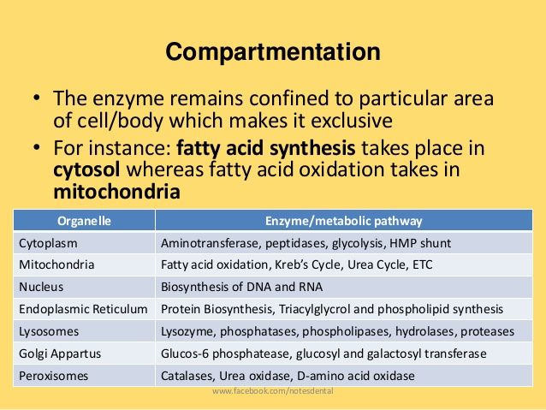

Slide 10
History of enzymes

Slide 11
As early as the late 17th and early 18th centuries, the digestion of meat by stomach secretions and the conversion of starch to sugars by plant extracts and saliva were known. However, the mechanism by which this occurred had not been identified.
In the 19th century, when studying the fermentation of sugar to alcohol by yeast, Louis Pasteur came to the conclusion that this fermentation was catalyzed by a vital force contained within the yeast cells called "ferments", which were thought to function only within living organisms.

Slide 12
In 1897, Eduard Buchner submitted his first paper on the ability of yeast extracts that lacked any living yeast cells to ferment sugar. In a series of experiments at the University of Berlin, he found that the sugar was fermented even when there were no living yeast cells in the mixture. He named the enzyme that brought about the fermentation of sucrose "zymase". In 1907, he received the Nobel Prize in Chemistry "for his biochemical research and his discovery of cell-free fermentation".
Following Buchner's example, enzymes are usually named according to the reaction they carry out. Typically, to generate the name of an enzyme, the suffix -ase is added to the name of its substrate (e.g., lactase is the enzyme that cleaves lactose) or the type of reaction (e.g., DNA polymerase forms DNA polymers).

Slide 13
In 1926, James B. Sumner showed that the enzyme urease was a pure protein and crystallized it; Sumner did likewise for the enzyme catalase in 1937.
Northrop and Stanley (1930), who worked on the digestive enzymes pepsin, trypsin and chymotrypsin. These three scientists were awarded the 1946 Nobel Prize in Chemistry.

Slide 14
Chemical Nature of Enzymes

Slide 15
Most enzymes are protein in nature.
Some enzymes require the presence of certain additional organic or inorganic substances and are conjugated proteins.
Such enzymes are called as holoenzymes. The protein part of the conjugated protein is called apoenzymes.
The non-protein part is called prosthetic group.

Slide 16
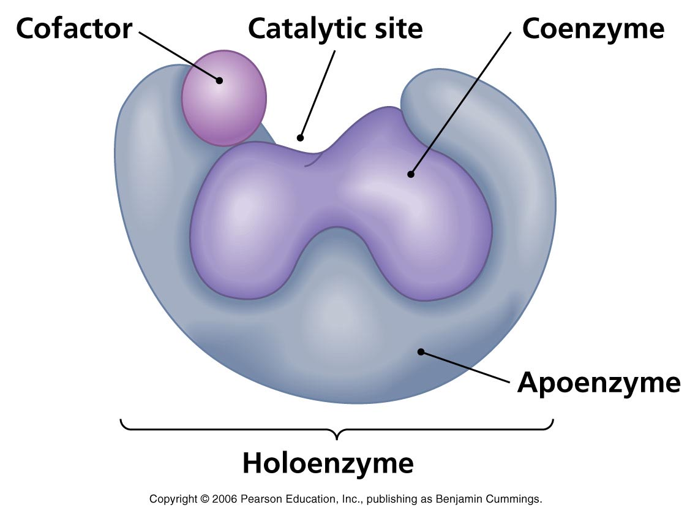

Slide 17
Several apoenzymes require the presence of metal ions such as Mg²⁺ (as Hexokinase), Zn²⁺ (for the activity of carboxypeptidase). Such inorganic ions are called cofactors.
If the metal ion is the integral part of the enzyme, such enzymes are called metalloenzymes.

Slide 18
Active Site

Slide 19
In biology, the active site is a small port in an enzyme where substrate molecules bind and undergo a chemical reaction.
The active site is usually found in a 3-D groove or pocket of the enzyme, lined with amino acid residues.
These residues are involved in recognition of the substrate.
After an active site has been involved in a reaction, it can be used again.

Slide 20
Mechanism of enzyme action

Slide 21
Enzymes can act in several ways, all of which lower ΔG‡ (energy of activation).
Lowering the activation energy by creating an environment in which the transition state is stabilized.
Substrates need a lot of energy to reach a transition state, which then decays into products. The enzyme stabilizes the transition state, reducing the energy needed to form products.

Slide 22
1. Lock and key model
Enzymes are very specific, and it was suggested by the Nobel laureate organic chemist Emil Fischer in 1894 that this was because both the enzyme and the substrate possess specific complementary geometric shapes that fit exactly into one another.
This is often referred to as "the lock and key" model. However, while this model explains enzyme specificity, it fails to explain the stabilization of the transition state that enzymes achieve.

Slide 23
2. Induced fit
The favored model for the enzyme-substrate interaction is the induced fit model.
This model proposes that the initial interaction between enzyme and substrate is relatively weak, but that these weak interactions rapidly induce conformational changes in the enzyme that strengthen binding.

Slide 24
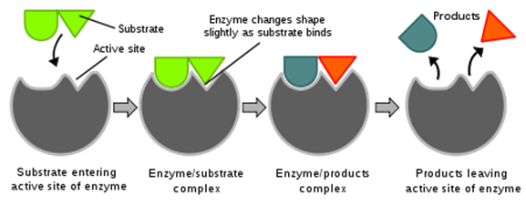

Slide 25
Michaelis constant K_{m}
As enzyme-catalysed reactions are saturable, their rate of catalysis does not show a linear response to increasing substrate. If the initial rate of the reaction is measured over a range of substrate concentrations (denoted as [S]), the reaction rate (v) increases as [S] increases. However, as [S] gets higher, the enzyme becomes saturated with substrate and the rate reaches V_{max}, the enzyme's maximum rate.
The Michaelis constant K_{m} is experimentally defined as the concentration at which the rate of the enzyme reaction is half V_{max}.

Slide 26
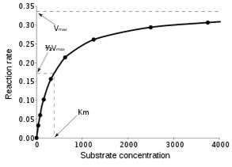

Slide 27
Classification of Enzymes

Slide 28
Enzymes are classified into six groups according to the International Union of Biochemistry (IUB). They are:
Oxidoreductases (EC1):
Enzymes involved in oxidation-reduction reactions.
E.g. Lactate dehydrogenase, Glyceraldehyde-3-phosphate dehydrogenase.
Transferases (EC2):
Enzymes transfer a particular group from one substrate to another. E.g. Alanine aminotransferase.
Hydrolases (EC3):
Hydrolyze the substrate with the addition of water molecule. E.g. Glucose 6-phosphatase, Amylase, Pepsin.

Slide 29
Lyases (EC4):
Catalyze the removal of a small molecule from a large substrate without the addition of water.
E.g. Fumarase and Enolase.
Isomerases (EC5):
They isomerize substrates.
Ligases (EC6):
Synthesize substances by joining two substrates with the utilization of energy. E.g. Glutamine synthetase.

Slide 30
EC number

Slide 31
The Enzyme Commission number (EC number) is a numerical classification scheme for enzymes, based on the chemical reactions they catalyze. As a system of enzyme nomenclature, every EC number is associated with a recommended name for the respective enzyme.
Every enzyme code consists of the letters "EC" followed by four numbers separated by periods. Those numbers represent a progressively finer classification of the enzyme.

Slide 32
For example, the tripeptide aminopeptidases have the code "EC 3.4.11.4", whose components indicate the following groups of enzymes:
EC 3 enzymes are hydrolases (enzymes that use water to break up some other molecule)
EC 3.4 are hydrolases that act on peptide bonds
EC 3.4.11 are those hydrolases that cleave off the amino-terminal amino acid from a polypeptide
EC 3.4.11.4 are those that cleave off the amino-terminal end from a tripeptide

Slide 33
Enzyme Specificity

Slide 34
1. Stereospecificity:
The group of enzyme catalyzes either L or D isomer.
2. Reaction Specificity:
One enzyme catalyzes only one type of reaction.
3. Substrate Specificity:
Absolute Specificity: Glucokinase acts on glucose only.
Group Specificity: Hexokinase catalyzes hexoses.

Slide 35
4. Bond Specificity:
Refers to the action of proteolytic enzymes, which act on peptide bonds of proteins.
5. Dual Specificity:
There are two types of dual specificity:
The enzyme act on two substrates by one reaction types. e.g. xanthine oxidase enzyme acts on xanthine and hypoxanthine (two substrates) by oxidation (one reaction type).
The enzyme act on one substrate by two different reaction types. e.g. isocitrate dehydrogenase enzyme acts on isocitrate (one substrate) by oxidation followed by decarboxylation (two different reaction types) to produce α-ketoglutrate as a reaction product.

Slide 36
Factors Affecting
Enzyme Activity

Slide 37
1. Effect of pH:
Each enzyme has an optimum pH at which the activity of the enzyme is maximum.
Either decreased or increased pH causes a decrease in enzyme activity. Examples of optimum pH are:
Pepsin has an optimum pH at (I-2).
Optimum pH for amylase is (6.8).
Optimum pH for ALP is (9.0).
Optimum pH for ACP is (5.0).

Slide 38
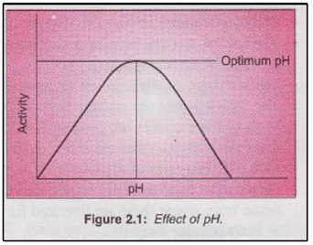

Slide 39
2. Effect of Temperature:
The temperature at which the enzyme activity is more is called optimum temperature.
The enzyme activity was duplicated for every increase in temperature by 10 degrees till reaching to the maximum velocity for enzyme activity at the optimum temperature.
After this point the enzyme activity decreases with the increment of temperature.
At 100ºC the enzyme will be denatured. While, at zero degree the enzyme will be kept inactivated and when the temperature increased the activity of enzyme will be increased.
Optimum temperature of enzymes in the human body is 37ºC.

Slide 40
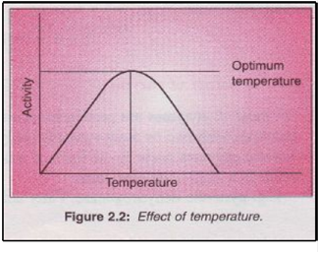

Slide 41
3. Effect of Substrate Concentration:
At low substrate concentration enzyme molecules are free initially and the ES complex (ES= enzyme-substrate) formation is proportional to the substrate concentration.
At higher concentration all the enzyme molecules are saturated with substrate. There will be no change in the activity further.
Hence in an enzyme reaction system more substrate is taken than the requirement.

Slide 42
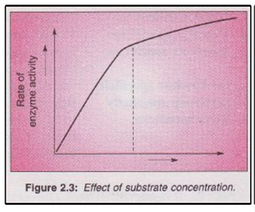

Slide 43
4. Effect of Enzyme Concentration:
The velocity of the enzyme reaction is directly proportional to the enzyme concentration.
5. Enzyme activators
6. Enzyme inhibitors

Slide 44
Enzyme Inhibitors

Slide 45
Enzyme inhibitors were classified into reversible and irreversible inhibitors
I. Reversible inhibitors
Reversible inhibitors bind to enzymes with non-covalent interactions (hydrogen bonds, hydrophobic interactions and ionic bonds).
Multiple weak bonds between the inhibitor and the active site combine to produce strong and specific binding.
Reversible inhibitors generally do not undergo chemical reactions when bound to the enzyme and can be easily removed by dilution or dialysis.

Slide 46
Classification of reversible inhibitors
A. Competitive inhibition
In competitive inhibition, the substrate and inhibitor cannot bind to the enzyme at the same time. This usually results from the inhibitor having an affinity for the active site of an enzyme where the substrate also binds.
The substrate and inhibitor compete for access to the enzyme's active site.
This type of inhibition can be overcome by sufficiently high concentrations of substrate (V_{max} remains constant).
K_{m} will increase as it takes a higher concentration of the substrate to reach the K_{m} point.
Competitive inhibitors are often similar in structure to the real substrate.

Slide 47
Example:
Malonate is a competitive inhibitor of succinate for succinate dehydrogenase

Slide 48
B. Non-competitive inhibition
The binding of the inhibitor to the enzyme reduces its activity but does not affect the binding of substrate.
The extent of inhibition depends only on the concentration of the inhibitor.
V_{max} will decrease due to the inability for the reaction to proceed as efficiently, Km will remain the same as the actual binding of the substrate will still function properly.

Slide 49
C. Uncompetitive inhibition
In uncompetitive inhibition, the inhibitor binds only to the substrate-enzyme complex.
This type of inhibition causes V_{max} to decrease and K_{m} to decrease.

Slide 50
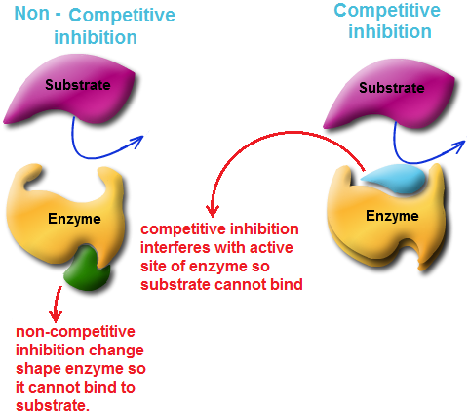

Slide 51
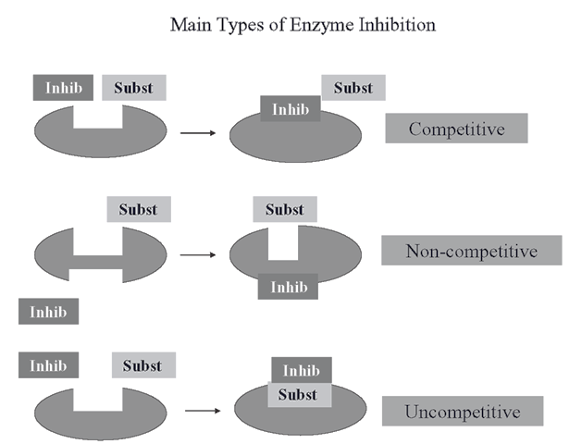

Slide 52
II. Irreversible inhibitors
Irreversible inhibitors usually covalently modify an enzyme, and inhibition cannot therefore be reversed.
Irreversible inhibitors often contain reactive functional groups react with amino acid side chains in the enzyme active sites to form covalent adducts.
The side chain of amino acid may be hydroxyl or sulfhydryl groups; these include the amino acids serine (as diisopropylfluorophosphate (DFP)), cysteine, threonine or tyrosine.
Irreversible inhibitors are generally specific for one class of enzyme and do not inactivate all proteins; they do not function by destroying protein structure but by specifically altering the active site of their target.

Slide 53
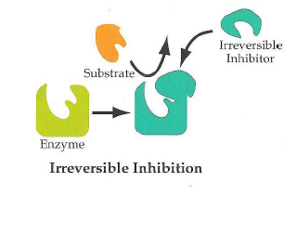

Slide 54
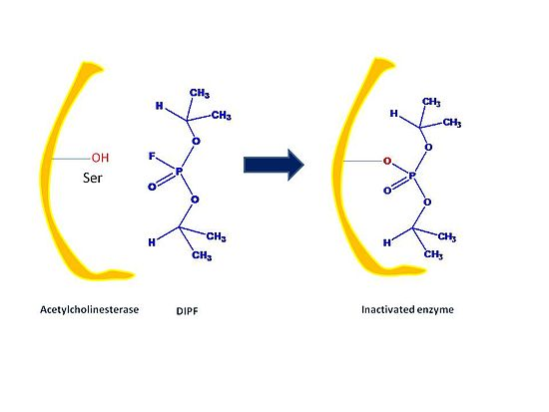

Slide 55
Cofactor

Slide 56
These proteins are commonly enzymes, and cofactors can be considered "helper molecules" that assist in biochemical transformations.
Cofactors are either organic or inorganic.
They can also be classified depending on how tightly they bind to an enzyme, with loosely-bound cofactors termed coenzymes and tightly-bound cofactors termed prosthetic groups.
An inactive enzyme, without the cofactor is called an apoenzyme, while the complete enzyme with cofactor is the holoenzyme.

Slide 57
Cofactors can be divided into two broad groups: organic cofactors, such as flavin or heme, and inorganic cofactors, such as the metal ions Mg²⁺, Cu⁺, Mn²⁺, or iron-sulfur clusters.
Organic cofactors are sometimes further divided into coenzymes and prosthetic groups.
Prosthetic group emphasizes the nature of the binding of a cofactor to a protein (tight or covalent) and, thus, refers to a structural property.

Slide 58
Ion | Examples of enzymes containing this ion
Cupric | Cytochrome oxidase
Ferrous or Ferric | Catalase, Cytochrome (via Heme)
Magnesium | Glucose 6-phosphatase, Hexokinase, DNA-polymerase
Manganese | Arginase
Molybdenum | Nitrate reductase
Nickel | Urease
Selenium | Glutathione peroxidase
Zinc | Alcohol dehydrogenase, Carbonic anhydrase, DNA polymerase

Slide 59
Organic cofactor
Organic cofactors are small organic molecules (with a molecular mass less than 1000 Da) that can be either loosely or tightly bound to the enzyme in case of tightly bound organic cofactor it is difficult to remove without denaturing the enzyme, it can be called a prosthetic group.
Vitamins can serve as precursors to many organic cofactors (e.g., vitamins B₁, B₂, B₆, B₁₂, niacin, folic acid) or as coenzymes themselves (e.g., vitamin C).
Many organic cofactors also contain a nucleotide, such as the electron carriers NAD and FAD, and coenzyme A, which carry acyl groups.

Slide 60
Zymogens (Proenzymes)

Slide 61
A zymogen (or proenzyme) is an inactive enzyme precursor.
A zymogen requires a biochemical change (such as a hydrolysis reaction revealing the active site, or changing the configuration to reveal the active site) for it to become an active enzyme.
The biochemical change usually occurs in a lysosome where a specific part of the precursor enzyme is cleaved in order to activate it.
The amino acid chain that is released upon activation is called the activation peptide.
The pancreas secretes zymogens partly to prevent the enzymes from digesting proteins in the cells in which they are synthesized.

Slide 62
Fungi also secrete digestive enzymes into the environment as zymogens. The external environment has a different pH than inside the fungal cell and these changes the zymogen's structure into an active enzyme.
The protein digesting enzymes (proteolytic enzymes) of the gastrointestinal tract are produced in the form of precursor. This is to prevent unwanted degradation of body self-proteins.
These precursor forms of enzymes (zymogen) are converted into active form by HCI and trypsin.
Pepsinogen → pepsin (HCl activates the pepsinogen).

Slide 63
Isoenzymes

Slide 64
Isozymes (also known as isoenzymes) are enzymes that differ in amino acid sequence but catalyze the same chemical reaction.
These enzymes usually display different kinetic parameters (e.g. different K_{m} values), or different regulatory properties.
Catalyze the same reactions but are formed from structurally different polypeptides.
They perform the same catalytic function.
Various isoenzymes of an enzyme can differ in three major ways:
Enzymatic properties
Physical properties (e.g heat stability)
Biochemical properties such as amino acid composition and immunological reactivities.

Slide 65
Lactate dehydrogenase (LDH)
Pyruvate → Lactate (anaerobic glycolysis)
LDH is elevated in myocardial infarction, blood disorders
It is a tetrameric protein and made of two types of subunits namely H = Heart, M = skeletal muscle
It exists as 5 different isoenzymes with various combinations of H and M subunits

Slide 66
Isoenzyme name | Composition | Present in | Elevated in
LDH₁ | ( H₄) HHHH | Myocardium, RBC | myocardial infarction
LDH₂ | (H₃M₁) HHHM | Myocardium, RBC
LDH₃ | (H₂M₂) HHMM | Kidney, Skeletal muscle
LDH₄ | (H₁M₃) HMMM | Kidney, Skeletal muscle
LDH₅ | (M₄) MMMM | Skeletal muscle, Liver | Skeletal muscle and liver diseases

Slide 67
Creatine Kinase (CK)
Creatine + ATP → phosphocreatine + ADP
(Phosphocreatine – serves as energy reserve during muscle contraction)
Creatine kinase is a dimer made of two monomers occurs in the tissues.
Skeletal muscle contains M subunit, Brain contains B subunits.
Three different isoenzymes are formed.

Slide 68
Isoenzyme name | Composition | Present in | Elevated in
CK-1 | BB | Brain | CNS diseases
CK-2 | MB | Myocardium/ Heart | Acute myocardial infarction
CK-3 | MM | Skeletal muscle, Myocardium

Slide 69
Allosteric modulation
Allosteric sites are sites on the enzyme that bind to molecules in the cellular environment.
The sites form weak, noncovalent bonds with these molecules, causing a change in the conformation of the enzyme.
This change in conformation translates to the active site, which then affects the reaction rate of the enzyme.
Allosteric interactions can both inhibit and activate enzymes and are a common way that enzymes are controlled in the body.

Slide 70
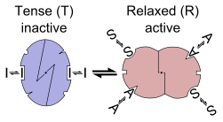

Slide 71
Clinical Enzymology

Slide 72
Serum enzymes increases may be due to:-
Cell death - this results in a small short-lived increase (e.g., following myocardial infarction).
Increased cell membrane permeability in living cells (due to hypoxia, inflammation, drugs/poisons, cellular swelling) gives rise to a large protracted increase in serum enzymes as there is ongoing enzyme synthesis (e.g., Duchenne muscular dystrophy, acute viral hepatitis).
Increased synthesis in a specific cell type (e.g., gamma glutamyl transferase in liver cells is induced by alcohol or anticonvulsant drugs, alkaline phophatase in liver cells is induced by obstruction, lactate dehydrogenase is induced in neoplastic tissues).

Slide 73
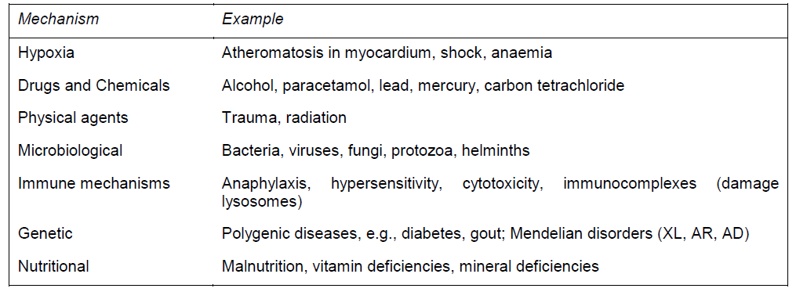
CAUSES OF CELL DAMAGE OR DEATH

Slide 74
CREATINE KINASE (CK)

Slide 75
Important in tissues where significant metabolic energy is stored as creatine phosphate.
Distribution : skeletal muscle, heart, brain.
Isoenzyme composition : CK is a dimer consisting of sub-units M or B coded by two distinct genes.
Thus 3 possible isoenzymes - M M ; M B ; B B
Skeletal muscle - all MM; Heart - 80% MM, 20% MB; Brain - all BB.
Normal pattern in serum - predominantly MM present, with MB < 6% of total CK.

Slide 76
Myocardial infarction
Early increase of total CK, specifically the MB isoenzyme.
Total CK levels start to rise at about 6 hours , peak at 18 to 30 hours, and return to normal by 3 days.
If total CK raised, measurement of CK-MB is indicated.
CK-MB levels may be raised by 4 hours, are almost certain to be raised by 12 hours, and may return to normal by 24 hours after MI.
Used as a diagnostic test before 24 hours, and as a prognostic indicator (amount of increase reflects extent of cardiac damage).

Slide 77
Skeletal muscle damage
e.g., trauma, surgery (especially in cardiac surgery), over-exercise, convulsions, ischaemia, inflammation (myositis), malignant hyperthermia, congenital muscular dystrophy.
increase of total CK, but MB isoenzyme not increased. In neurogenic muscle disease, e.g., poliomyelitis and Parkinsonism, CK levels are normal.
In Duchenne Muscular Dystrophy, CK elevation precedes onset of symptoms by years, and falls as disease progresses.
In chronic muscle disease there is reversion to the foetal isoenzyme pattern (MB appears in skeletal muscle and serum).
Hypothyroidism is associated with high total CK levels.

Slide 78
LACTATE DEHYDROGENASE (LDH, LD)

Slide 79
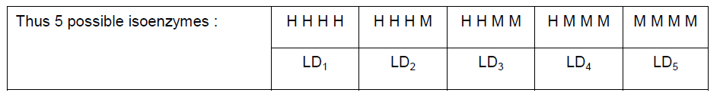
Important in the disposal of glycolytically generated NADH, particularly when mitochondrial disposal is impaired by hypoxia.
Distribution: ubiquitous, including heart, skeletal muscle, liver and RBCs - specificity is improved by isoenzyme analysis.
LD is a tetramer consisting of sub-units H or M coded by two different genes.

Slide 80
Anoxic tissues (liver, muscle) express M subunit, thus LD5 predominates.
Erythrocyte precursors and heart express the H subunit, hence LD1 predominates in these tissues.
Normal pattern in serum - predominantly LD2, with slightly less LD1, and even less LD3, LD4 and LD5.

Slide 81
Myocardial infarction - late and long-lasting increase in total LD. Total LD levels start to rise at about 8 to 12 hours, peak at 24 to 48 hours and return to normal by 10 days. The predominant isoenzyme is LD1, which is present in greater concentration than the normal LD2 (flipped pattern).
Liver damage, including viral or toxic hepatitis (ethanol, paracetamol overdose, carbon tetrachloride), cardiac failure (liver congestion) - increase in total LD, exclusively due to LD5.

Slide 82
Hematological disorders - often isolated elevation in total LD. Due to breakdown of circulating red cells or red cell precursors in bone marrow.
Intra-vascular (or in vitro) haemolysis, e.g., due to an auto-immune disorder, prosthetic heart valve, inherited enzyme deficiency (G6PD, PK) - both LD1 and LD2 increased. Associated features include elevated serum unconjugated bilirubin, increased urine and stool urobilinogen, and decreased haptoglobin.
Megaloblastic anaemia due to folate or vitamin B₁₂ deficiency : failure of cell division leads to cell lysis and enzyme release from the bone marrow - predominant increase in LD1 (as in myocardial infarction). Extremely high levels can be achieved.

Slide 83
Malignant tumours may manifest an isolated increase in serum LD due to enhanced synthesis of glycolytic enzymes by a wide variety of neoplasms (even measured in aqueous humour to diagnose retinoblastoma).
Typically centripetal isoenzyme pattern (LD2, LD3 and LD4) due to expression of both subunits (H and M). An exception is seen in germ cell tumours which show an increase in LD1.

Slide 84
TRANSAMINASES

Slide 85
ASPARTATE TRANSAMINASE (AST) (aspartate +α-ketoglutarate -----> oxaloacetate + glutamate).
ALANINE TRANSAMINASE (ALT) (alanine + α-ketoglutarate -----> pyruvate + glutamate).
Wide distribution in tissues, including liver, skeletal muscle, heart, kidney and RBCs.
Cofactor vitamin B6 (pyridoxine) - carries amino acid intermediates.

Slide 86
Acute hepatitis - high, sustained elevations of both ALT and AST (up to 100 x normal).
ALT higher especially in mild injury; precedes onset of jaundice (allows early diagnosis.
Disproportionate AST elevation indicates liver cell necrosis (involving mitochondria) or ethanol induced damage (acetaldehyde formed during ethanol metabolism depletes cytosolic pyridoxine, hence ALT activity selectively lost).
Myocardial infarction - AST elevation of 5 - 10 x normal. AST levels start to rise at about 6 to 8 hours, peak at 18 to 24 hours and return to normal by 4 to 5 days. ALT hardly increases at all.
AST always greater than ALT (de Ritis quotient AST/ALT > 5. In liver disease this ratio is usually < 1).

Slide 87
ALKALINE PHOSPHATASE (ALP)

Slide 88
Located in membranes, specifically the brush borders of the PCT of the kidney, the small intestinal mucosa, both the sinusoidal and canalicular surfaces of the hepatocyte, in osteoblasts in bone and in the placenta.
Important in the formation of new bone by osteoblasts.
Normal level in serum is determined by age and sex, reflecting periods of active bone growth, i.e., very high in young children.
Normal pattern in children is preponderance of bone isoenzyme, while in adults liver isoenzyme predominates.

Slide 89
Bone disease
Reflects increased osteoblastic activity i.e., bone synthesis.
High levels of total ALP, due to increased bone isoenzyme, seen in:
active bone growth (young children, at puberty, healing fractures).
Primary bone tumours (osteogenic sarcoma).
secondary tumours evoking a sclerotic response e.g., prostatic and breast metastases.
Rickets (children) and osteomalacia (adults).
long-standing primary or secondary hyperparathyroidism (e.g., chronic renal disease where calcium is resorbed from bone, leading to renal osteodystrophy)

Slide 90
Liver disease
Classic marker of cholestasis due to extra-hepatic (gallstones) or intra-hepatic (drugs, inflammation) obstruction.
Synthesis of liver isoenzyme induced by biliary obstruction - differentiates obstruction from hepatocellular damage. Elevated liver ALP without jaundice suggests :
Intermittent or incomplete obstruction (gallstone).
Intra-hepatic space-occupying mass (tumour).

Slide 91
Placental isoenzyme
is found in the serum in late pregnancy and remains elevated a week or two after delivery.

Slide 92
GAMMA GLUTAMYL TRANSFERASE (GGT)

Slide 93
γ-glutamyl-N-donor + acceptor --> γ-glutamyl-N-acceptor + donor.
Distribution :
It present in all cells except muscle.
Located in cell membranes and endoplasmic reticulum of hepatocytes.
Role:
Synthesis of reduced glutathione (GSH) required for drug detoxification e.g., paracetamol.
Normal level in serum derived from liver.

Slide 94
Hepatic synthesis of GGT is induced by biliary obstruction.
Serum levels correlate with liver ALP and 5’ nucleotidase.
Very sensitive and specific marker of liver disease.
Hepatic synthesis of GGT is also induced by drugs (especially barbiturates, antidepressants and anticonvulsants) and alcohol.
Serum GGT is increased not just in patients with alcoholic liver disease, but also in people who are heavy drinkers.

Slide 95
ACID PHOSPHATASE (ACP)

Slide 96
Distribution
Prostate, lysosomes of all cells, red blood cells (avoid hemolysis). Number and genetics of isoenzymes not known, but at least prostatic and red cell isoenzymes exist.
Identify prostatic isoenzyme by L-tartrate inhibitable activity.
ACP is temperature and pH labile. So, specimens for enzyme assay should be submitted on ice.

Slide 97
Prostatic CA. High activity of ACP, especially the prostatic isoenzyme, indicates disseminated disease (usually spreads to bone). CA-in-situ and benign hypertrophy of the pr normal levels of ACP. Recently, ACP assays have been largely replaced by measurement of prostate-specific antigen.
2. Gaucher’s disease, bone destruction by infection and neoplasia. Lysosomal isoenzyme - tartrate insensitive, normal RIA result. ostate usually have

Slide 98
AMYLASE

Slide 99
Distribution
Amylase secreted by the pancreas and salivary glands; also present in Fallopian tubes and small intestine.
Two common isoenzymes occur, a pancreatic (P) and salivary (S) type, which can be differentiated using a wheat germ lectin which selectively inhibits the S isoenzyme.

Slide 100
Acute pancreatitis
an increase in total amylase, in the appropriate clinical setting, is suggestive of acute pancreatitis.
In cases of an acute abdomen, determination of isoenzyme type is seldom helpful - P isoenzyme is increased not only in acute pancreatitis, but also in perforated peptic ulcer and intestinal obstruction/ infarction
Amylase only remains elevated in the serum for 3 to 4 days, but remains elevated in the urine for longer (6 days). Levels of both amylase and lipase are normal in chronic pancreatitis.

